Slide 1
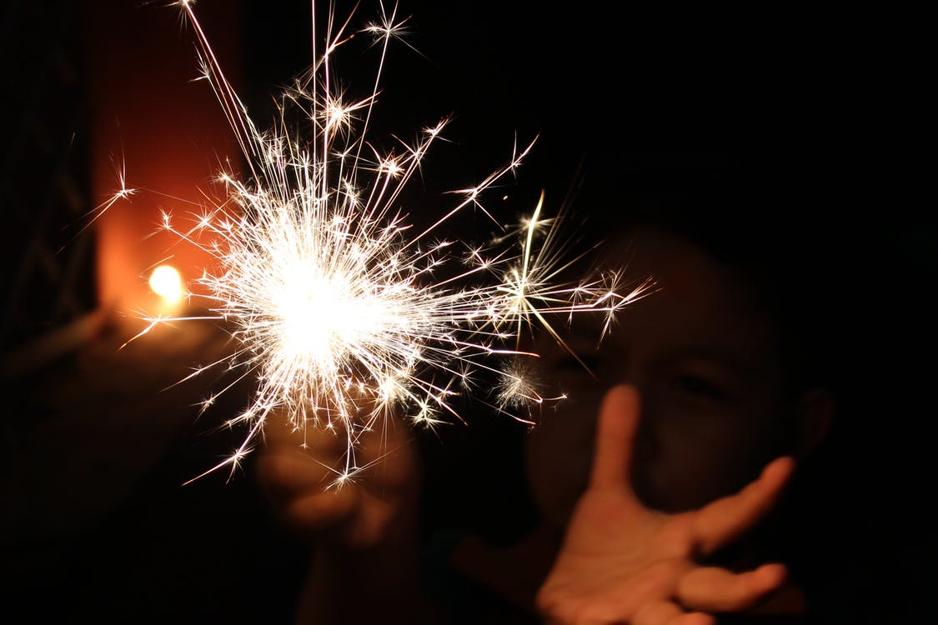
BEHOLD THE LOVE OF GOD
1 JOHN 3:1-3

Slide 2
I John 3:1-3
See what kind of love the Father has given to us, that we should be called children of God; and so we are. The reason the world does not know us is that it did not know him. Beloved, we are God’s children now, and what we will be has not yet appeared; but we know that when he appears we shall be like him, because we shall see him as he is. And everyone who thus hopes in him purifies himself as he is pure.

Slide 3
I John 3:1-3
See…

Slide 4
I John 3:1-3
See what kind of love the Father has given to us…

Slide 5
I John 3:1-3
See what kind of love the Father has given to us, that we should be called children of God; and so we are…

Slide 6
A Different Kind of Love
“God loves me because I am _______”
vs.
“I am who I am, because God loves me”

Slide 7
I John 3:1-3
See what kind of love the Father has given to us, that we should be called children of God; and so we are. The reason the world does not know us is that it did not know him…

Slide 8
I John 3:1-3
See what kind of love the Father has given to us, that we should be called children of God; and so we are. The reason the world does not know us is that it did not know him. Beloved, we are God’s children now, and what we will be has not yet appeared; but we know that when he appears we shall be like him, because we shall see him as he is…

Slide 9
Romans 5:8
“God shows His love for us in that while we were still sinners, Christ died for us.”

Slide 10
I John 3:1-3
See what kind of love the Father has given to us, that we should be called children of God; and so we are. The reason the world does not know us is that it did not know him. Beloved, we are God’s children now, and what we will be has not yet appeared; but we know that when he appears we shall be like him, because we shall see him as he is. And everyone who thus hopes in him purifies himself as he is pure.

Slide 11
I John 3:1-3
See what kind of love the Father has given to us, that we should be called children of God; and so we are. The reason the world does not know us is that it did not know him. Beloved, we are God’s children now, and what we will be has not yet appeared; but we know that when he appears we shall be like him, because we shall see him as he is. And everyone who thus hopes in him purifies himself as he is pure.

